Slide 1
Mythology
Lesson Plans

Slide 2
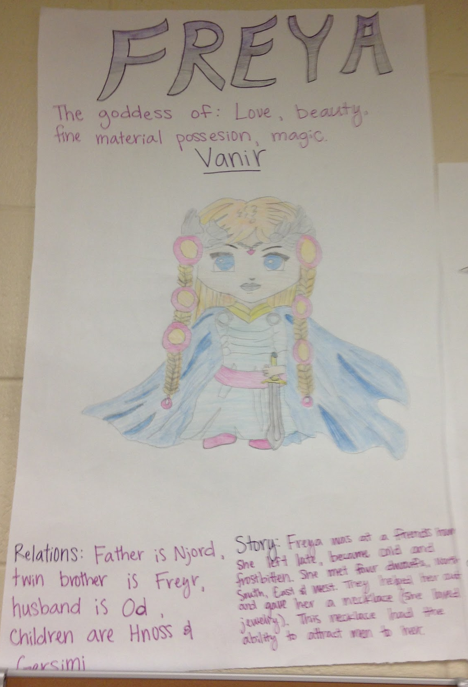
The 12 Great Olympians
I’ll divide you into groups. You will be responsible for one of the 12 Great Olympians found on pp.32-36 of the book Mythology.
On your computer paper, you will include …
picture of the god/dess
god of...
symbol
story
relationships
name: Greek/Roman

Slide 3
The 12 Great Olympians
Three Olympians from the text are not included in this video (3 min.): https://www.youtube.com/watch?v=eJCm8W5RZes Identify which 3 god/desses were left out.
Play Kahoot (65 question quiz)

