Slide 1
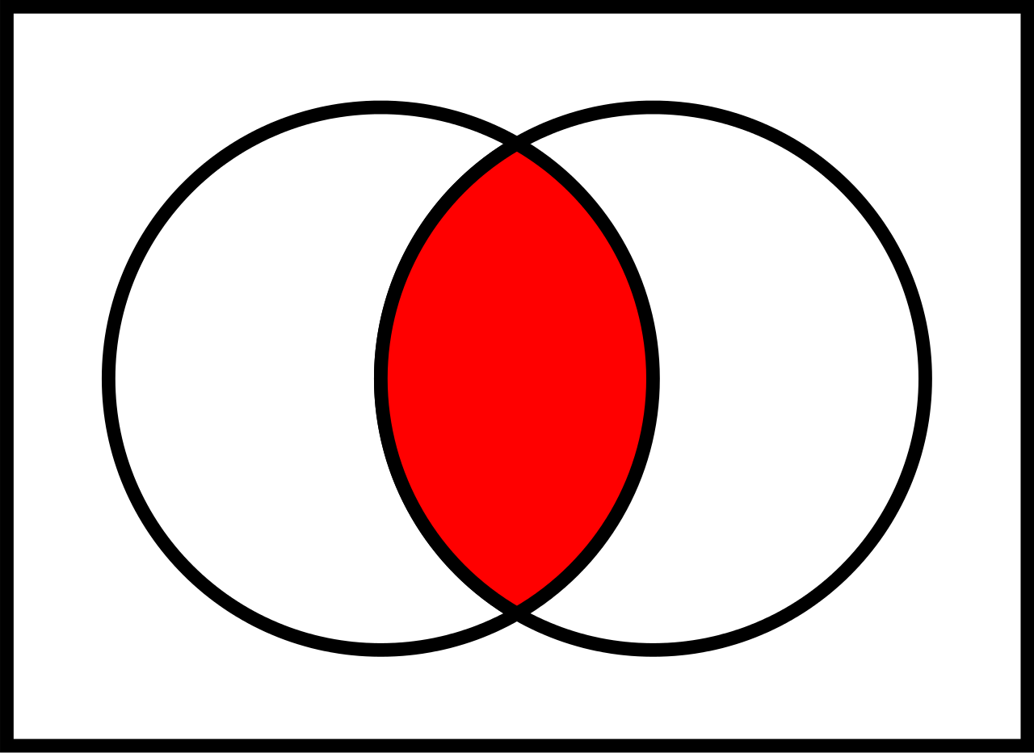
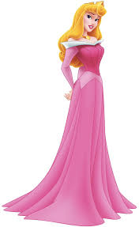
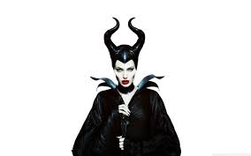
Compare and contrast
Watch Sleeping Beauty (75 min.)
Watch Maleficent (97 min.)
How is the P.O.V. different and how does that cater to a different audience?
Pronouns
Narrator
Setting
Details
What elements were essential to keep in both versions?
What did you dis/like? Why?

