Slide 1
Mythology
Lesson Plans

Slide 2
Week 2
Creation Myths

Slide 3
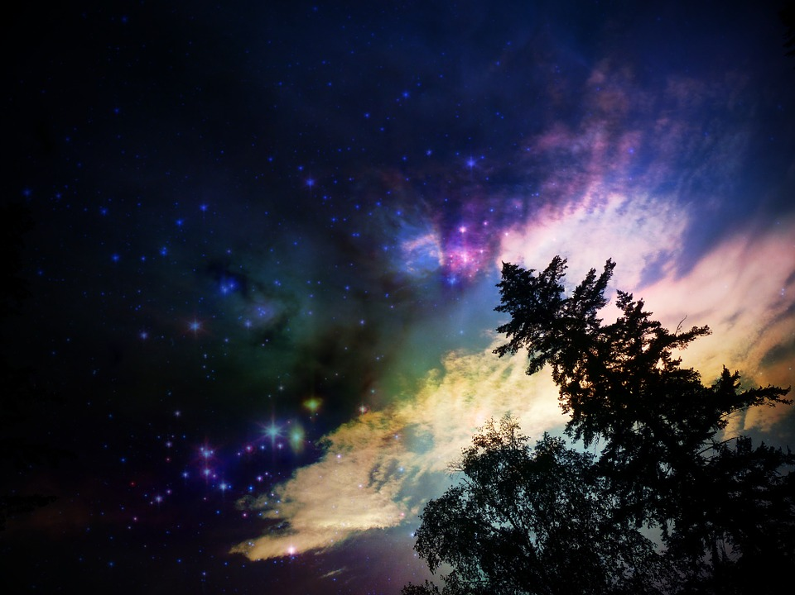
Creation Stories
Cronus and Zeus (5 min.)
The 3 generations family tree: (6 min.)
Chinese creation story (3 min.)
Hindu creation story (2 min.)
Notes:
*3 gen. vid. has nudity

Slide 4
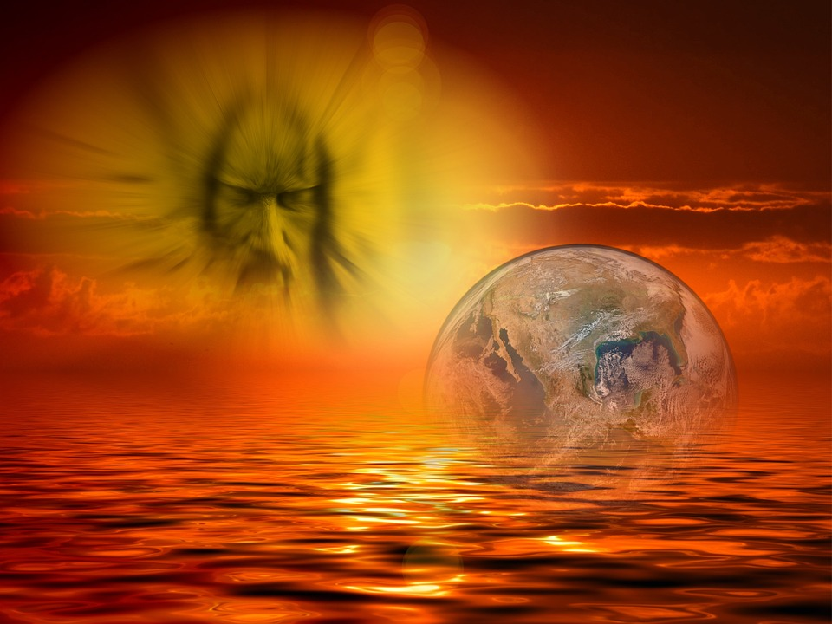
Creation Stories
Mayan creation story (3m in.)
Egyptian creation story (3 min.)
Other creation myths available to read
Part 1 chapter 3: “How the World and Mankind Were Created” Mythology pp.65-77

Slide 5
Creation Stories
Creation of woman (8 min. video): Pandora’s box (Mythology pp. 72- 74)
What values are illustrated in this story?
What is the moral to this story?
Gallery walk: walk around the room to take note of each goddess. I’ll time you 1 min. / station (there are 8 stations)
Design mythological Barbie

Slide 6
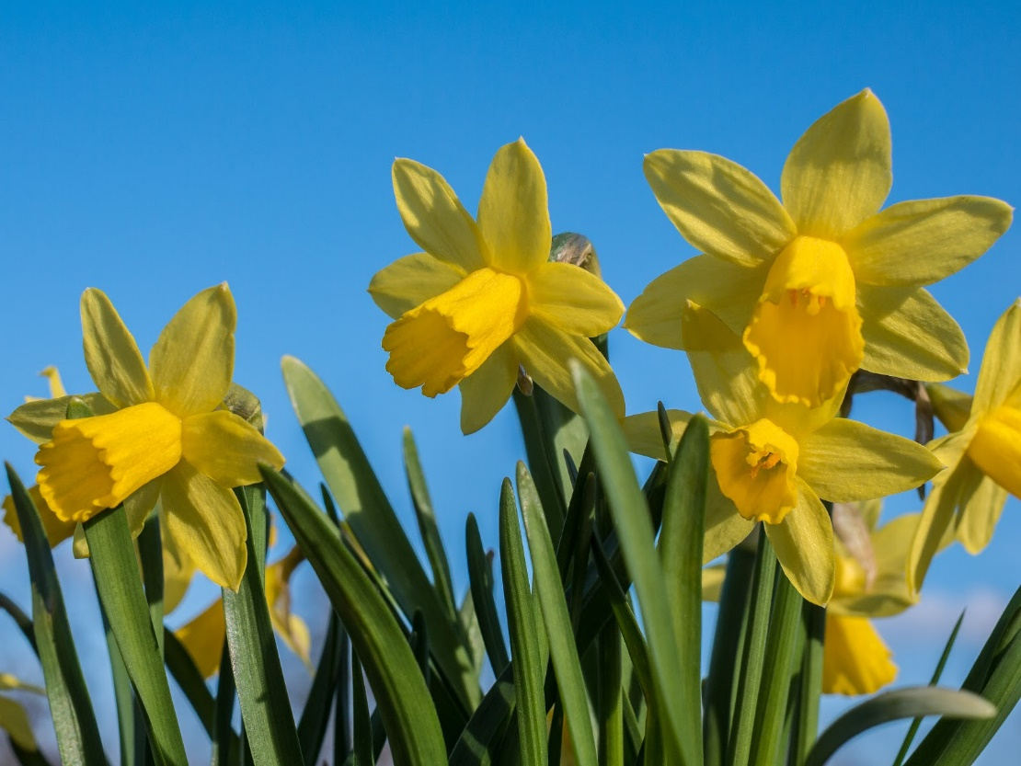
Nature Stories
Narcissus and Echo
Define terms
Read the play
Answer and discuss the questions.
Watch the story (5 min.)
The story of Demeter
Read Mythology pp. 50-55
Watch about Demeter and the 4 seasons (8 min.)
Notes:
Make an ecopy of the play and then reserve laptops for students to read. That way I can avoid using so much paper.

