Slide 1
Greek Tragedy
Lesson plans 2017

Slide 2
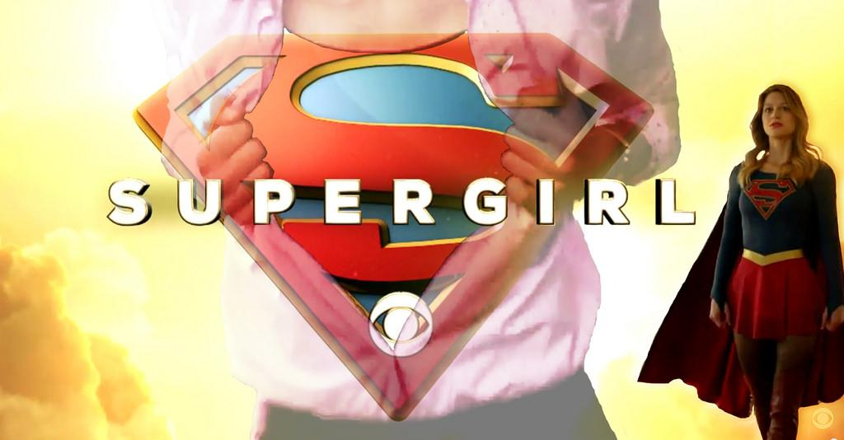
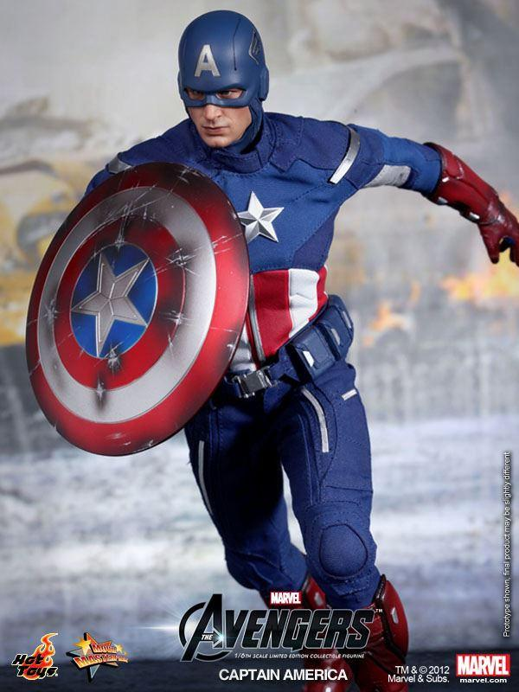
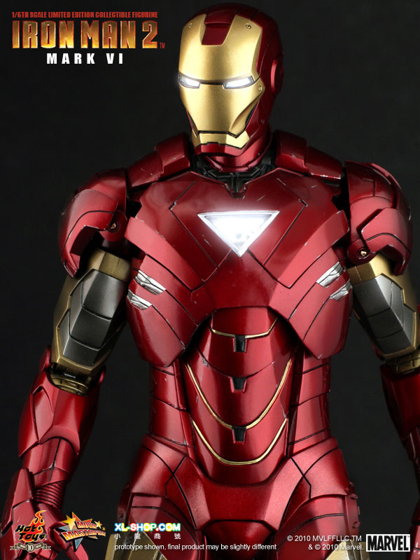
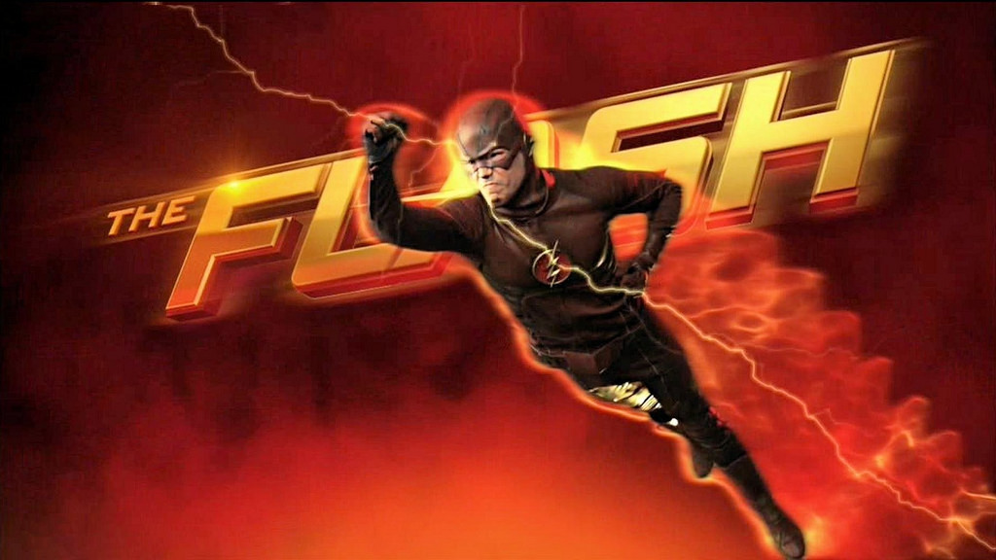
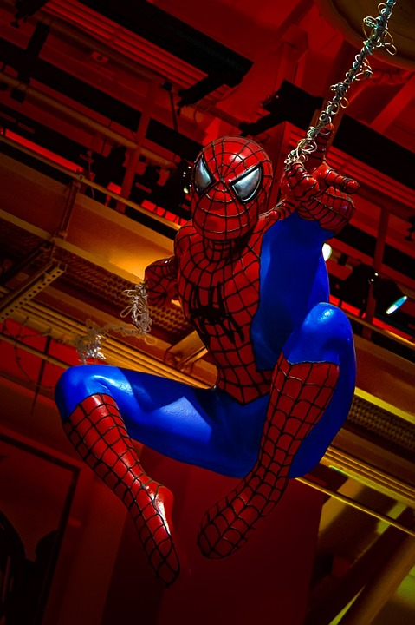
What do all of these shows have in common?

Slide 3
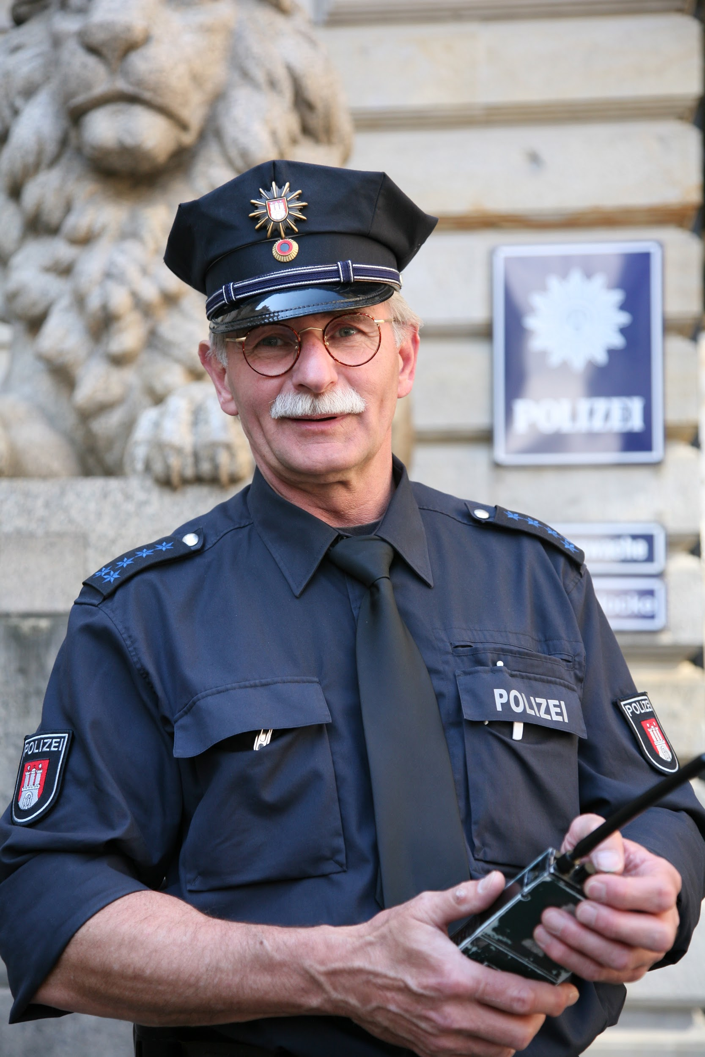
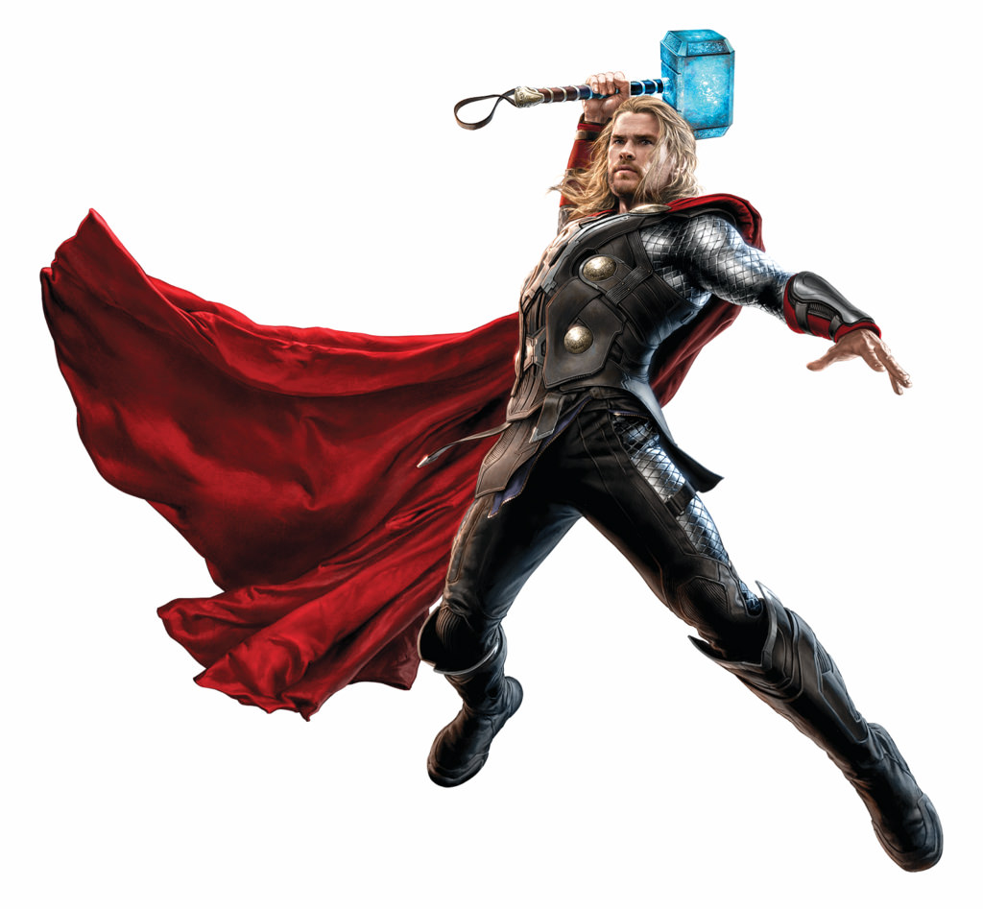
What makes a hero?
Definition
Characteristics
Examples
Compare and contrast super heroes and modern heroes.
Notes:
7 min. video

Slide 4
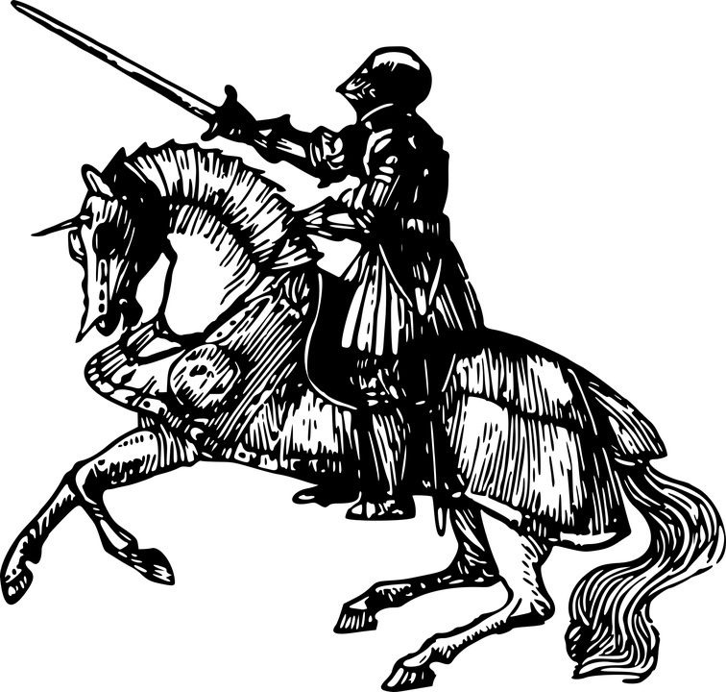
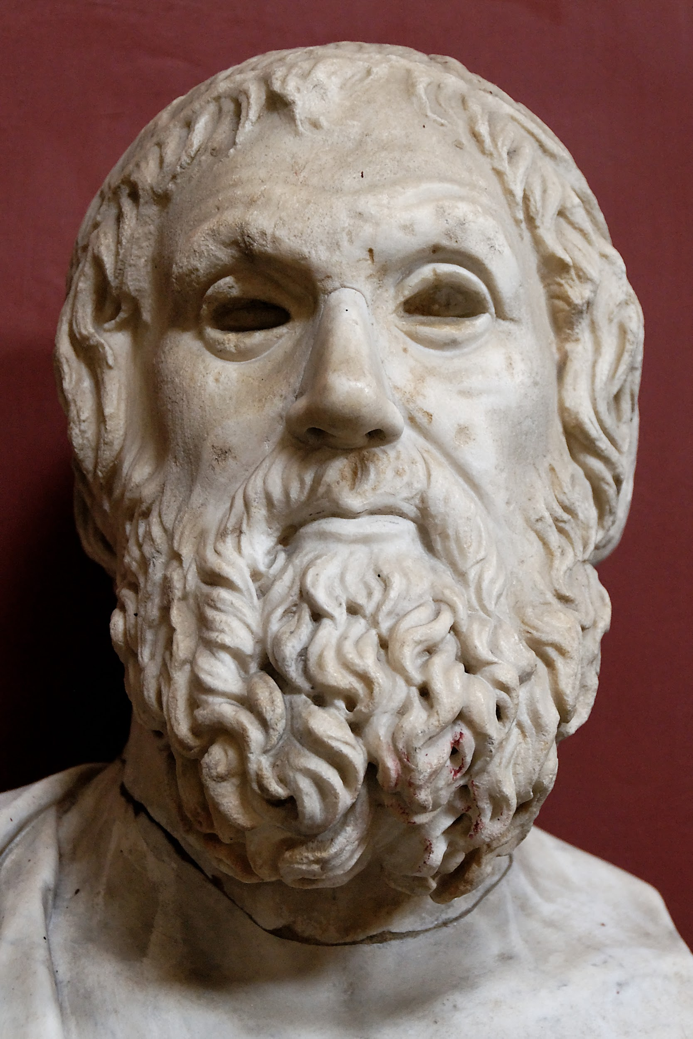
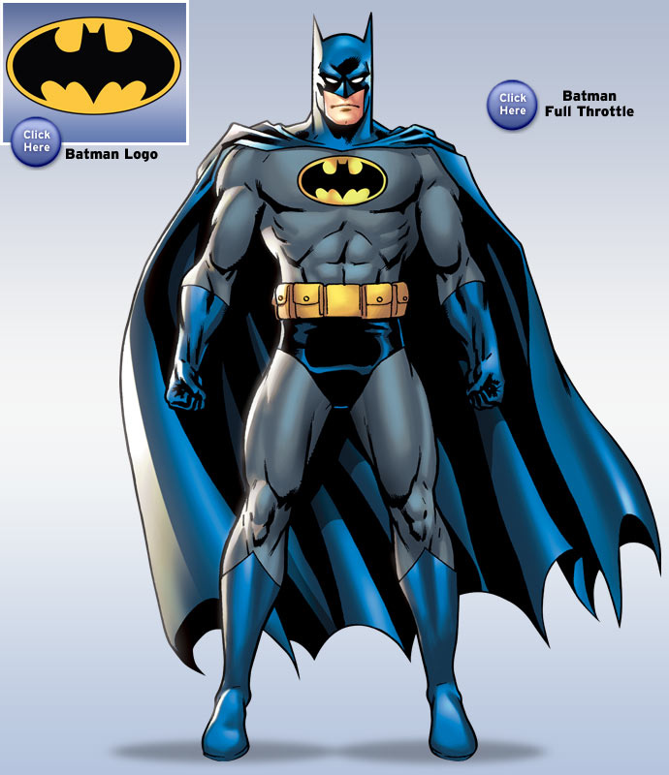
Different kinds of heroes
Super hero
Tragic hero
Romantic hero

Slide 5
What is Greek Tragedy?
Definition
Structure
Origin
Characteristics
Read pp. 958-959
Notes:
Video is about 7 min.

Slide 6
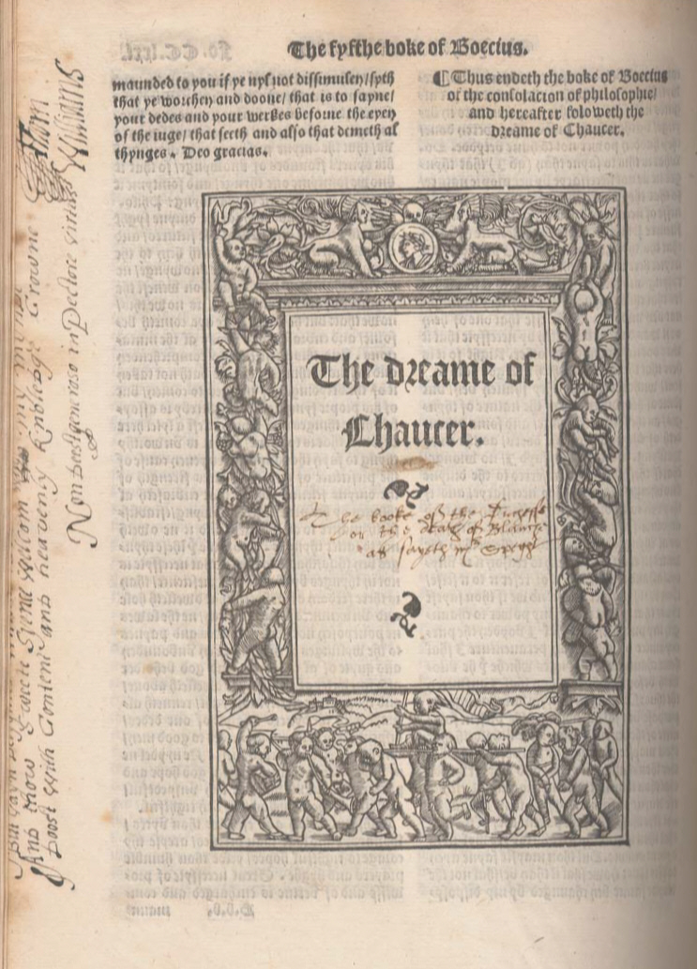
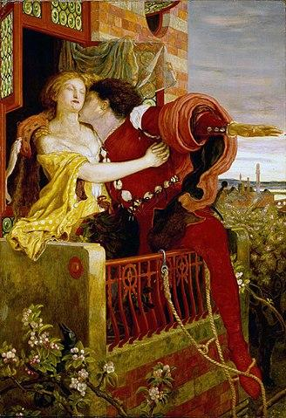
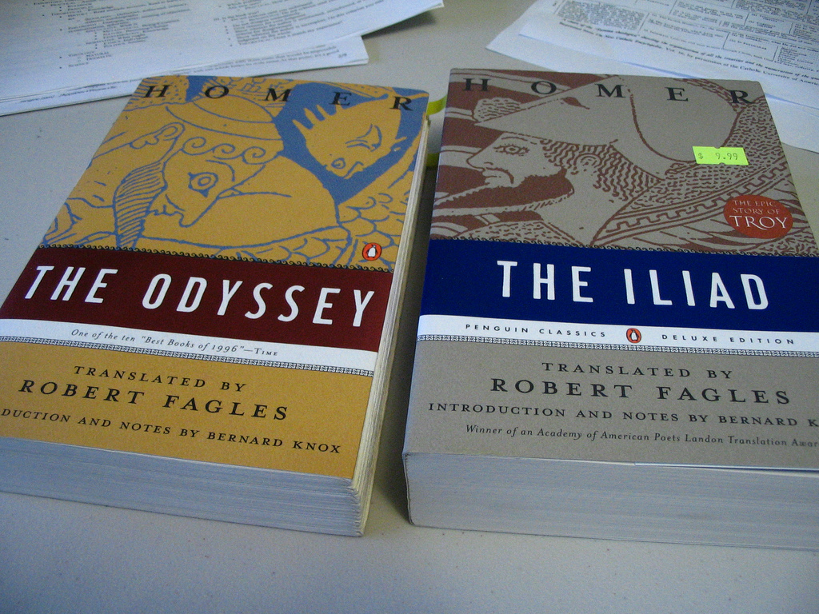
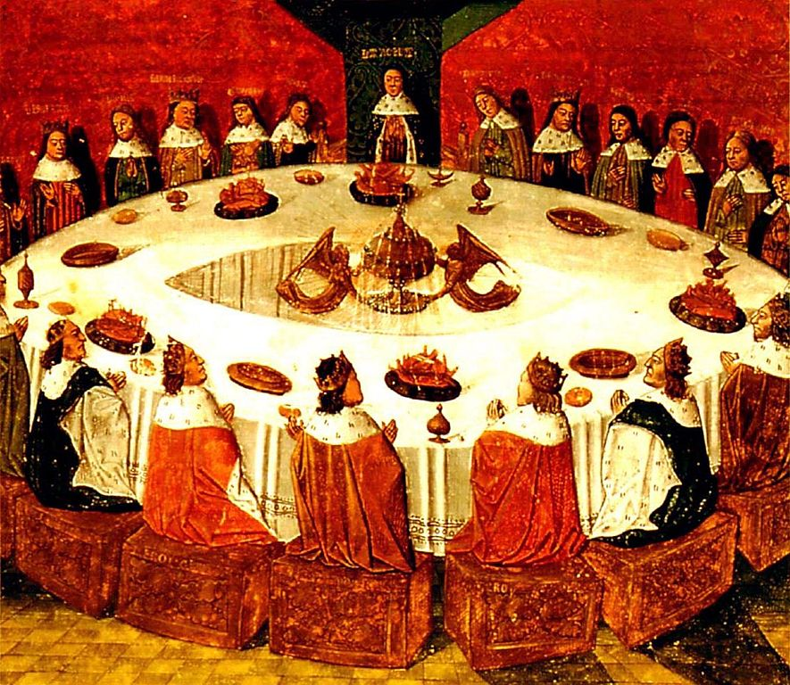
Timeline of some tragedies/medieval romance
Sophocles 496-406 B.C.
Geoffrey Chaucer 1343-1400 A.D.
Shakespeare 1564-1616 A.D.
Homer 8th century 700 A.D.
Sir Thomas Malory 1405-1471 A.D.
Notes:
Oldest story = epic of gilgamesh (written in cuneiform found in modern-day iraq) 2000 B.C.
Guttenberg printing press - 1440

Slide 7
Watch Antigone and answer these questions
In Antigone, who is the real main character — Antigone or Creon? Make a case to support your choice.
Discuss the differences between Antigone and Ismene in their views of women in society. How does each sister's view shape the choices she makes in the play? How consistent is each in her view?
Is Antigone primarily a drama of politics or of fate. Defend your answer.
As a prophet, Tiresias speaks for the gods and for Fate. How does the character of Tiresias function dramatically in Antigone?
Who is the tragic hero in Antigone? Defend your answer using the terms we learned and characteristics of tragic heroes of which we took note.

