Slide 1
Week 3
More Monsters, Creatures and Characters

Slide 2
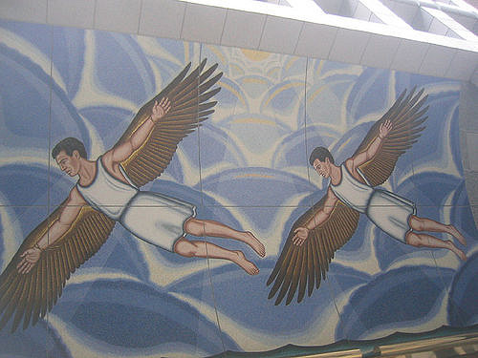
The Lesser gods and creatures
Pretest
Read pp. 36-48
Sign up for presentation
Time in lab to prepare
Grading rubric
Notes:
CCSS: SL 11-12.4 present information, findings, and supporting evidence, conveying a clear and distinct perspective …
SL 11-12.5 Make strategic use of digital media…
SWBAT share knowledge of greek characters through a presentation and post test

Slide 3
Read, summarize, share
The Inventor’s Apprentice
Is fame a worthwhile goal?
How can jealousy be destructive?
How can inventions change the world?
What two inventions does Perdix create?
What inspires the creation of one of his inventions?
What place has Daedalus always dreamed of visiting?
What does Daedalus hope to accomplish with his inventions?
What is strange about the perdix bird?
Daedalus and Icarus
When should you listen to advice?
What are the dangers of “playing God”?
When you make mistakes are there always second chances?
What is the difference between intelligence and wisdom?
What was Daedalus’ greatest creation?
Why is Minos holding Daedalus prisoner?
How do Daedalus and Icarus escape?
What two warnings does Daedalus give his son?
What mistake does Icarus make?

