Slide 1
Mythology
Lesson Plans

Slide 2
C.C.S.S. Standards
RL. 11-12.5 Analyze how an author's choices concerning how to structure specific parts of a text contribute to its overall structure and meaning as well as its aesthetic impact.
RL. 11-12.6 Analyze a case in which grasping point of view requires distinguishing what is directly stated in a text from what is really meant.
RI. 11-12.7 Integrate and evaluate multiple sources of information presented in different media or formats as well as in words in order to address a question or solve a problem.
W. 11-12.2 Write informative/explanatory texts to examine and convey complex ideas, concepts and information clearly and accurately…
W. 11-12.10 Write routinely...

Slide 3
C.C.S.S. Standards
SL. 11-12.2 Integrate multiple sources of information presented in diverse formats and media in order to make informed decision and solve problems evaluating the credibility and accuracy of each source and noting any discrepancies among the data.
SL. 11-12.4 Present information, findings, and supporting evidence, conveying a clear and distinct perspective…
SL. 11-12. 5 Make strategic use of digital media in presentations to enhance understanding...

Slide 4
Week 11
Literature of Africa and the Middle East
European Literature from the Middle Ages to the Enlightenment

Slide 5
Historical and cultural context
Read and discuss pp. 488-502
Watch Myths that mystify (20 min).

Slide 6
African folktales
Read and discuss pp. 50-513

Slide 7
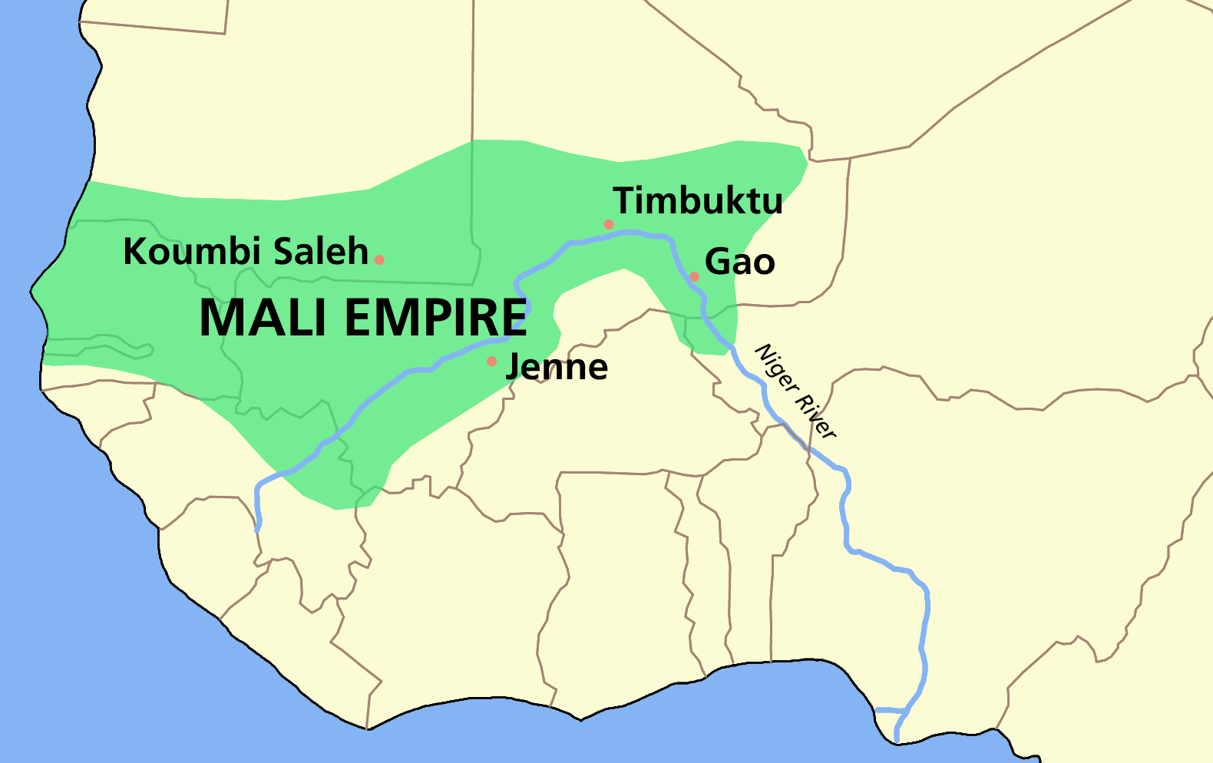
Mali epic
Read and discuss pp. 518-535

Slide 8
Week 12
CECAs

