Slide 1
Mythology
Lesson Plans

Slide 2
C.C.S.S. Standards
RL. 11-12.5 Analyze how an author's choices concerning how to structure specific parts of a text contribute to its overall structure and meaning as well as its aesthetic impact.
RL. 11-12.6 Analyze a case in which grasping point of view requires distinguishing what is directly stated in a text from what is really meant.
RI. 11-12.7 Integrate and evaluate multiple sources of information presented in different media or formats as well as in words in order to address a question or solve a problem.
W. 11-12.2 Write informative/explanatory texts to examine and convey complex ideas, concepts and information clearly and accurately…
W. 11-12.10 Write routinely...

Slide 3
C.C.S.S. Standards
SL. 11-12.2 Integrate multiple sources of information presented in diverse formats and media in order to make informed decision and solve problems evaluating the credibility and accuracy of each source and noting any discrepancies among the data.
SL. 11-12.4 Present information, findings, and supporting evidence, conveying a clear and distinct perspective…
SL. 11-12. 5 Make strategic use of digital media in presentations to enhance understanding...

Slide 4
Week 10
Ancient Middle East
Literature of India, China, and Japan

Slide 5
Literature of India, China, and Japan
Read Holt’s World Literature textbook pp. 348-364.
Discuss and take note.
Watch video about Vedic period. (8 min.)
Watch video about Confucianism, Taoism, and Buddhism (8 min.)
Watch video about Shintoism (5 min.)
Notes:
Bell ringer: What are the foundations of a good life?

Slide 6
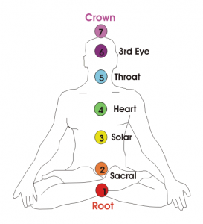
Meditation
7 chakras video clip (10 min.)
Yoga
Read savasana article
Zen (Japanese music and nature sounds)

Slide 7
Indian mythology
How Lord Ganesha got his elephant head (3min.)

Slide 8
Chinese mythology
9 popular gods of China (15 min.)
The most powerful boy in Chinese legend (5 min.)

Slide 9
Japanese mythology
Creation myth (5min.)

Slide 10
Reenactment
Read your assigned text.
Rama and Ravana in Battle pp.388-399
From The Analects pp. 407-411
Zen Parables pp. 464-467
Then prepare your roles to reenact what you read in front of the class.
Bring props 5 pts.
Dress in costume 5pts.
No reading lines (besides a narrator if you choose one) 5 pts.
Must focus on the conflict, theme, and resolution of the story 5 pts.

