Slide 1
Narrative Writing

Slide 2
Characteristics of well-written narratives
Exposition: The text creatively engages the reader by setting out a well-developed conflict, situation, or observation. The text establishes one or multiple points of view and introduces a narrator and/or complex characters.
Narrative Techniques and Development: The text demonstrates sophisticated narrative techniques such as engaging dialogue, artistic pacing, vivid description, complex reflection, and multiple plot lines to develop experiences, events, and/or characters.
Notes:
Common core rubrics (including narratives) can be found here: http://mhsenglishdepartment.weebly.com/uploads/3/4/0/5/3405281/common_core_rubrics_gr9-10.pdf

Slide 3
Characteristics of well-written narratives
Organization and Cohesion: The text creates a seamless progression of experiences or events using multiple techniques—such as chronology, flashback, foreshadowing, suspense, etc.—to sequence events so that they build on one another to create a coherent whole.
Style and Conventions: The text uses eloquent words and phrases, showing details and rich sensory language and mood to convey a realistic picture of the experiences, events, setting, and/or characters.
Conclusion: The text moves to a conclusion that artfully follows from and thoughtfully reflects on what is experienced, observed, or resolved over the course of the narrative.
Notes:
We’ve read a lot of narratives in class. Mimic any one of them because they all are well-written.

Slide 4
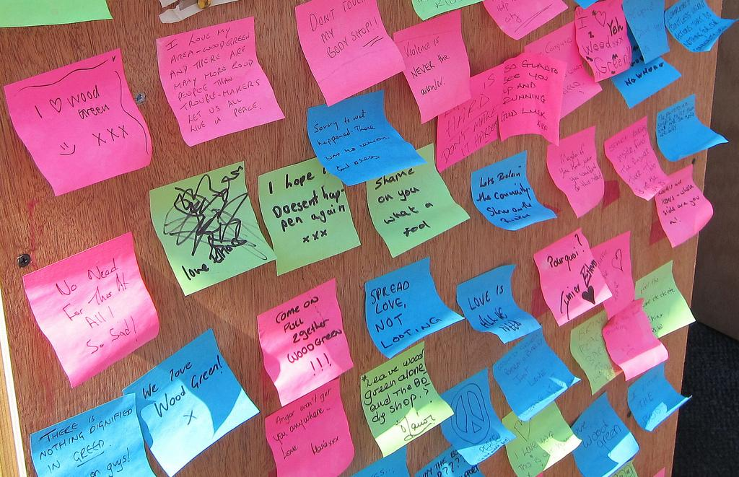
Post-it Note Activity
Write a conflict idea on one post-it
Write a setting idea on one post-it
Write a character description on one post-it (5 min.)
Post the plot under the plot spot on the board, the setting where it’s labeled setting and character where it is labeled character
Students then choose at random a plot, setting, and character situation from the board (may not pick your own post-its)
Write a story (at least 8 paragraphs) using the three post-its (60 min.)

Slide 5
Change POV
Using the same story, change the pronouns to alter point of view.
Make other adjustments to highlight a different point of view, but still honor the original story.
Rewrite a third time to change pov again. In the end, you will have 3 different povs
First (I, we, me, my)
Second (you)
Third (they, s/he, Aurora)

Slide 6
Foreshadow
A well-written story will have clues to how the story will end or other future events.
Use foreshadowing at least once in your story.
It may be simple, but it needs to be effective.
Examples from Disney
The King’s request for Maleficent’s wings foreshadows Stephan will take them.
Maleficent’s curse in both versions foreshadows Aurora’s demise.
Even a simple evil look from Cinderella’s evil step-mother foreshadows her evil plot to keep Cinderella from going to the ball.

Slide 7
Rubric: These are the elements I will score...
First person narrative (pronouns circled) 5 pts.
Second person narrative (pronouns circled) 5 pts.
Third person narrative (pronouns circled) 5 pts.
Foreshadowing (highlighted) 5 pts.
Conflict (underlined) 5 pts.
Mechanics 5 pts.
Notes:
Here are my pet peeves that a student will lose all 5 points in the mechanics section:
“i”
If font is not in TNR 12
The heading is not MLA perfect

