Slide 1
Mythology
Lesson Plans

Slide 2
C.C.S.S. Standards
RL. 11-12.5 Analyze how an author's choices concerning how to structure specific parts of a text contribute to its overall structure and meaning as well as its aesthetic impact.
RL. 11-12.6 Analyze a case in which grasping point of view requires distinguishing what is directly stated in a text from what is really meant.
RI. 11-12.7 Integrate and evaluate multiple sources of information presented in different media or formats as well as in words in order to address a question or solve a problem.
W. 11-12.2 Write informative/explanatory texts to examine and convey complex ideas, concepts and information clearly and accurately…
W. 11-12.10 Write routinely...

Slide 3
C.C.S.S. Standards
SL. 11-12.2 Integrate multiple sources of information presented in diverse formats and media in order to make informed decision and solve problems evaluating the credibility and accuracy of each source and noting any discrepancies among the data.
SL. 11-12.4 Present information, findings, and supporting evidence, conveying a clear and distinct perspective…
SL. 11-12. 5 Make strategic use of digital media in presentations to enhance understanding...

Slide 4
Learning Objective(s)
Students will be able to…
Demonstrate knowledge of gods and goddesses, and major characters in Greek mythology by correctly identifying characteristics, backgrounds, and actions of each.
Compare and contrast the characters of the Trojan war and their personal motives by writing, researching, and role playing.
Demonstrate knowledge of The Odyssey and the culture behind it.

Slide 5
Week 9
Norse Mythology

Slide 6
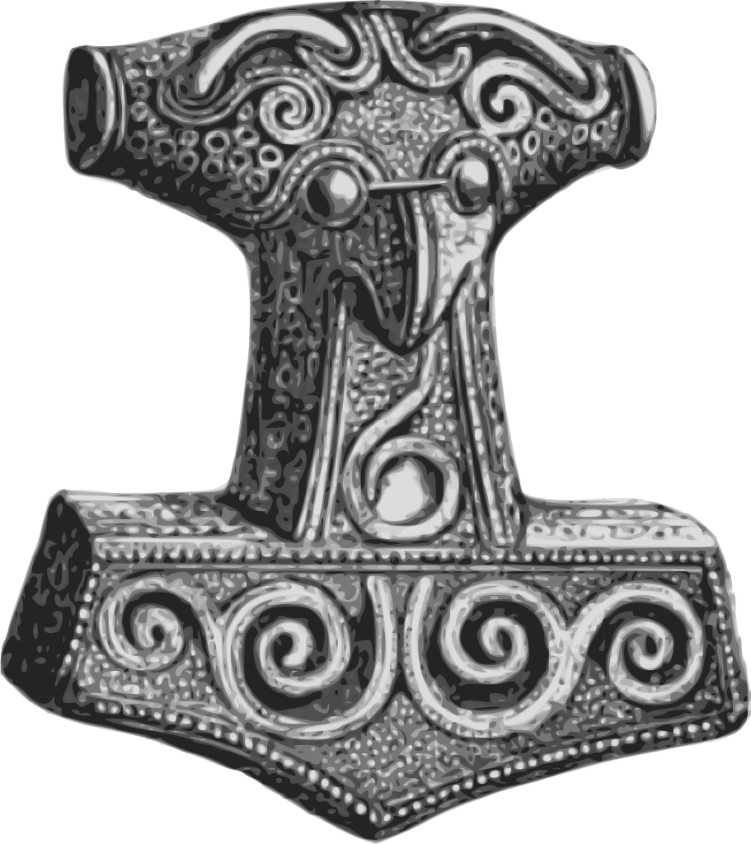
Norse Mythology
Introduction to characters, places, and viking people ppt.
Watch clips from “Thor” by Marvel
Read d’Aulgaires’ “Heimdall, the Watchman of Asgard”
Notes:
“Immigrant Song” by Led Zepplin

Slide 7
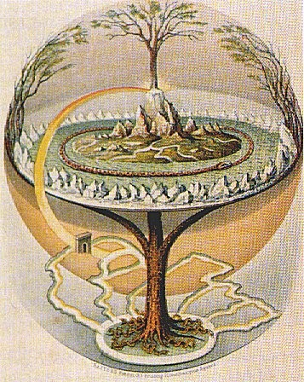
Norse Mythology: 9 Realms
Asgard: home to the Aesir
Vanaheim: home of the Vanir
Alfheim: home of the light elves
Midgard: Middle earth, home of man
Jotunheim: home of the giants
Svartalfheim: home of the dark elves
Nidavellir: home of the dwarfs
Niflheim: north, underground is Helheim (home of the dead)
Muspelheim: South, home of fire giants and demons

Slide 8
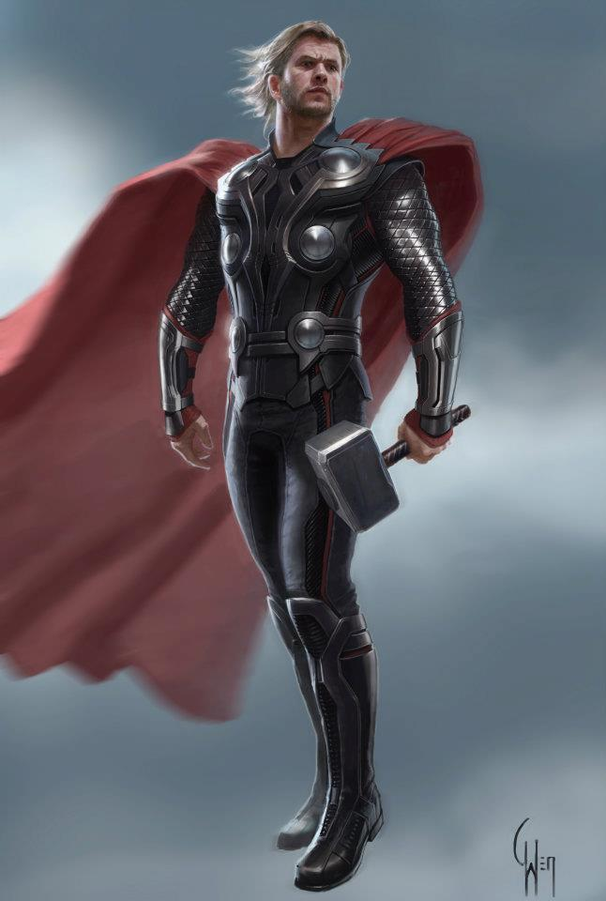
Norse Mythology: Gods
Odin:god of rain (Wednesday)
Frigg: Odin’s wife (Friday)
Thor: god of lightning; marries Sif (Thursday)
Balder: god of light; most pure and beloved
Hod or Hoder: blind; Loki tricks him to throw mistletoe that kills Balder
Tyr: (Tuesday)
Heimdall: Guards Asgard and Bifrost the rainbow road
Bragi:
Hermod:
Vidar:
Vali
Loki: half god, half giant; treated like a brother or Thor’s servant

Slide 9
Norse Mythology
“Clash of the Gods:Norse Mythology” (the first 12 min.)
In your notes answer the following: What connections do you make with Norse stories and other stories you are familiar with?
Read stories from d’Aulaires’ Norse Gods and Giants

Slide 10
Norse Mythology
Read and discuss:
Edith Hamilton’s Mythology part 7
“The Building of the Wall” (25 min. audio)
“The Fallen Valkyrie”
“The Apples of Iduna”

