Slide 1
Shakespeare’s Julius Caesar
Lesson Plans

Slide 2
Objectives
SWBAT define and identify the elements of drama and tragedy in Shakespeare’s Julius Caesar.
SWBAT Analyze why Brutus betrays Caesar and defend if the assassination was justifiable.(RL.9-10.3).

Slide 3
Online text
http://shakespeare.mit.edu/julius_caesar/full.html
or
http://www.william-shakespeare.info/script-text-julius-caesar.htm
Or
a google search will lead you to many options

Slide 4
Drama and tragedy characteristics
Tragic hero (1086)
Dramatic irony (1086)
Soliloquy (1086)
Aside (1086)
High social rank, flawed, suffers ruin
Audience knows, but characters don’t
Solo speech
Remark to audience or character, but no one else can hear

Slide 5
Drama and tragedy characteristics
Blank verse (1088)
Rhetorical devices (1088)
Repetition (1088)
Parallelism (1088)
Rhetorical questions (1088)
Unrhymed iambic pentameter
How you convey your message
“I have a dream speech”
Grammar structure
Question not meant to be answered

Slide 6
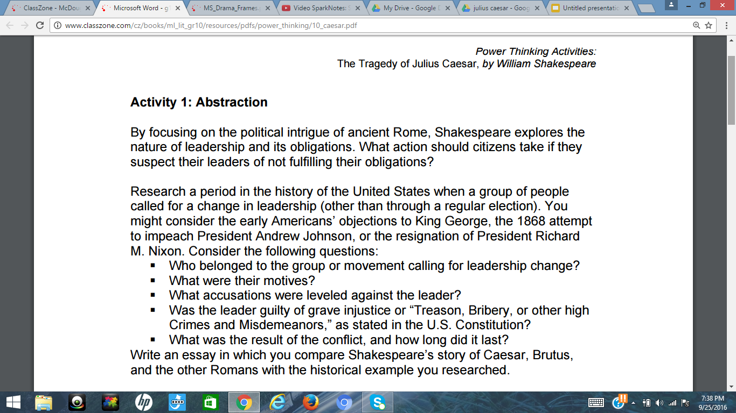
Activity suggestions by Marzano
Notes:
http://www.classzone.com/cz/books/ml_lit_gr10/resources/pdfs/power_thinking/10_caesar.pdf

Slide 7
Activity suggestions by Marzano
Notes:
Use the tree map to complete this task.

Slide 8
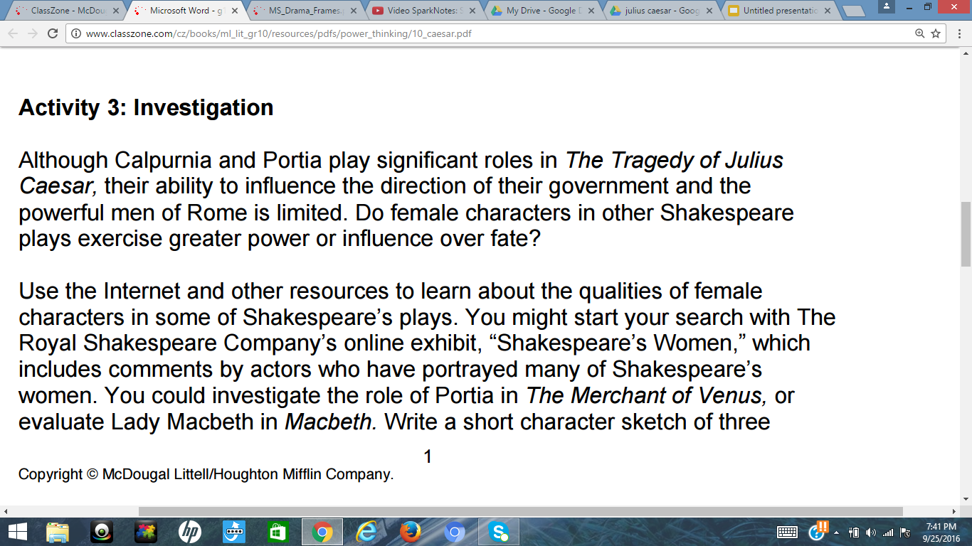
Activity suggestions by Marzano
Notes:
This idea may be more appropriate if I taught seniors ro a class that only read Shakespeare. As it is, it would be difficult for students to form an educated idea because their experience with the texts is severely limited.

Slide 9
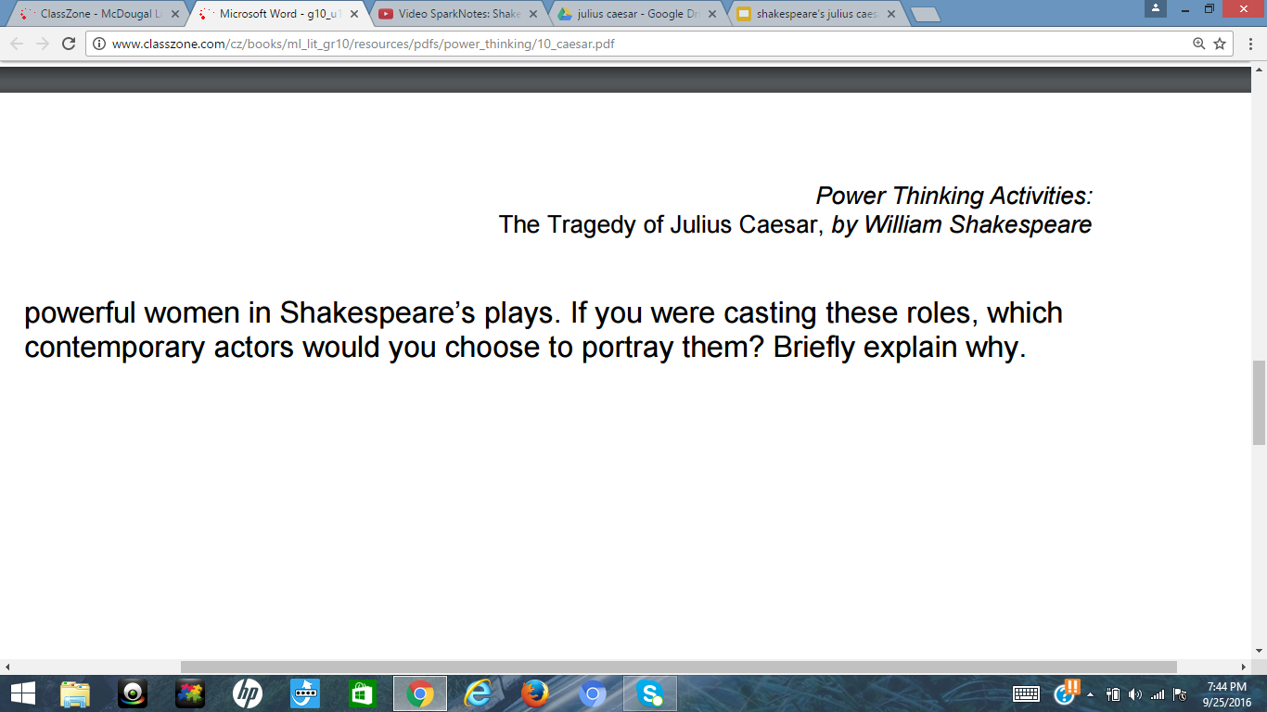
Activity suggestions by Marzano

Slide 10
Historical background
Notes:
https://www.youtube.com/watch?v=wgPymD-NBQU

Slide 11
Shakespeare background
http://www.worldbookonline.com/student/article?id=ar504520&st=shakespeare#tab=homepage

Slide 12
The play’s background
http://www.worldbookonline.com/student/article?id=ar737154&st=shakespeare#tab=homepage
Notes:
madisonhighlibrary.weebly.com

Slide 13
Gaius Julius Caesar background
http://www.worldbookonline.com/student/article?id=ar086860&st=julius+caesar#tab=homepage

Slide 14
Summary of the play
Notes:
https://www.youtube.com/watch?v=kgyAPrv30eg

Slide 15
Rhetoric
What is rhetoric: https://www.youtube.com/watch?v=mIESu4yXco4
Rhetorical question (pg. 1088)
Repetition (pg. 1088)
Parallelism (pg. 1088)

Slide 16
Audiobook
https://www.youtube.com/watch?v=lnLahYbq_7Q
(start 3 min. in)

Slide 17
Unit 11 test
http://www.classzone.com/cz/books/ml_lit_gr10/secured/teacher/resources/pdfs/assessment_file/AS_Book2_L10B.pdf
Pgs. 245-253 (easy version)
Pgs. 257-265 (challenging version)

