Slide 1
Mythology
Lesson Plans

Slide 2
C.C.S.S. Standards
RL. 11-12.5 Analyze how an author's choices concerning how to structure specific parts of a text contribute to its overall structure and meaning as well as its aesthetic impact.
RL. 11-12.6 Analyze a case in which grasping point of view requires distinguishing what is directly stated in a text from what is really meant.
RI. 11-12.7 Integrate and evaluate multiple sources of information presented in different media or formats as well as in words in order to address a question or solve a problem.
W. 11-12.2 Write informative/explanatory texts to examine and convey complex ideas, concepts and information clearly and accurately…
W. 11-12.10 Write routinely...

Slide 3
C.C.S.S. Standards
SL. 11-12.2 Integrate multiple sources of information presented in diverse formats and media in order to make informed decision and solve problems evaluating the credibility and accuracy of each source and noting any discrepancies among the data.
SL. 11-12.4 Present information, findings, and supporting evidence, conveying a clear and distinct perspective…
SL. 11-12. 5 Make strategic use of digital media in presentations to enhance understanding...

Slide 4
Learning Objective(s)
Students will be able to…
Demonstrate knowledge of gods and goddesses, and major characters in Greek mythology by correctly identifying characteristics, backgrounds, and actions of each.
Compare and contrast the characters of the Trojan war and their personal motives by writing, researching, and role playing.
Demonstrate knowledge of The Odyssey and the culture behind it.

Slide 5
Week 6
The Iliad

Slide 6
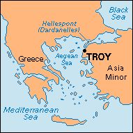
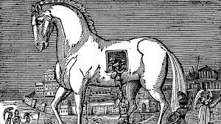
The Iliad
Who Started the Trojan War?
Read Apple of Discord
Take notes on Whodunnit? worksheet
Write an argumentative essay to defend your answer
Read writing ideas
Grade using argumentative rubric

Slide 7
The Iliad
Achaeans (p. 10)
Agamemnon
Achilles
Protroclus
Odysseus
Diomedes
Great Ajax
Little Ajax
Trojans (p. 10)
Hector
Priam
Hecuba
Paris
Helen
Aeneas
Andromache
Astyanax
Polydamas
Nestor
Meneleus
Idomeneus
Machaon
Calchas
Phoenix
Peleus
The myrmidons
Glaucus
Agenor
Dolon
Pandarus
Antenor
Sarpedon
Chryseis
Briseis
Chryses

Slide 8
The Iliad
Gods: Team Achaeans
Hera
Athena
Poseidon
Hephaestus
Gods: Team Troy
Zeus
Thetis
Apollo
Aphrodite
Artemis
Ares
Notes:
Hermes is messenger for all gods so may contribute to a team. Iris only serves as a messenger for Zeus so may be considered on his team. Thetis helps the Trojans because Achilles gets mad at Agamemnon and Achilles seeks retribution.

Slide 9
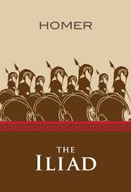
The Iliad
Read and discuss
The Judgement of Paris
The Tides of War
War at Troy
The Rage of Achilles
The Marooned Prince
The Fall of Troy
Watch (12 min.)
Notes:
Day 1 students watch the 12 min video and then read play and write a summary of it.
Day 2 students draw a comic strip on butcher paper with at least 3 scenes that include dialogue or explanatory text.
Day 3 students answer questions in their notebooks and share with the class what they read and the answer to their questions.
Answering after-reading questions meets CCSS RL. 11-12.6 Analyze a case in which grasping point of view requires distinguishing what is directly stated in a text from what is really meant.

Slide 10
The Iliad
Prepare discussion
Prepare questions to ask peers
Prepare textual evidence
Prepare personal connections
All must participate without the teacher intervening for a 5-min. conversation
Participate in Socratic seminar
Ask question(s)
Use textual evidence
Share opinion
Make personal connection

