Slide 1
Unit 1
plot, setting, mood
Notes:
5 elements of any short story: https://www.youtube.com/watch?v=c6I24S72Jps

Slide 2
CCSS
RL 9-10.1: cite strong and thorough textual evidence to support analysis...
RL 9-10.4: determine the meaning of words and phrases...including figurative and connotative meanings...and the impact of word choice...
RL 9-10.7: analyze the representation of a subject or key scene in two different artistic mediums...
Notes:
Common core state standards book: https://www.sde.idaho.gov/academic/social-studies/files/common-core/Common-Core-State-Standards.pdf
Exit slips: Today’s learning objective was… We learned this by… The terms I need to know are… __ means…
Bell ringers will meet ccss W 9-10.10: write routinely (students should keep a notebook that they continue to add their reflections)

Slide 3
Objective(s)
SWBAT analyze...
plot
setting
mood
conflict...
and cite textual evidence for their claims.

Slide 4
Define terms pp.24-31
Plot
Exposition
Rising action
Climax
Falling action
Resolution
Setting
Notes:
Examples of mood vs. tone: https://www.youtube.com/watch?v=YcCrsVK5dWs
Visuals of mood and tone: https://www.youtube.com/watch?v=jDUhDV-72S0

Slide 5
Vocabulary words: Harrison Bergeron
Define these words and use them in a sentence:
Vigilance (p. 34)
Wince (p. 36)
Consternation (p. 38)
Cower (p. 39)
Synchronize (p. 40)
Neutralize (p. 40)

Slide 6
Read Harrison Bergeron pp. 32-43
Draw conclusions pp 33-34
Reading questions
Notes:
Average reading level

Slide 7
Read Everyday Use pp. 44-59
Define and use:
Furtive (p. 50)
Recompose (p. 50)
Doctrine (p. 52)
Heritage (p. 55)
Define conflict
Define inferences
Make inferences as you read. Use the chart.
character | inference
maggie
mama
dee
Notes:
Average reading level
Bell ringer: Complete the “quickwrite” found on page 44.
Bell beater: kahoot game

Slide 8
Define term pp.24-25
mood

Slide 9
Read Searching for Summer pp. 60-73
Bell ringer: What do you take for granted? Write your response on a post-it note and stick to the back board.
Use context clues
Define mood and tone
Answer reading questions
“Stars, rainbows, and all other such heavenly sideshows had been permanently withdrawn, and if the radio announced that there was a blind of sunshine in such and such a place, where the cloud belt had thinned for half an hour, cars and buses would pour in that direction for days in an unavailing search for warmth and light.”
Describes something not lasting long.

Slide 10
Vocabulary words:To Build a Fire
Bell ringer: Define the following terms and use them in a sentence.
Setting (p. 75)
Antagonist (p. 75)
Foreshadowing (p. 75)
Intangible (p.76)
Conjectural (p. 78)
Apprehensive (p. 79)
Reiterate (p. 80)
Smite (p. 81)
Imperative (p.83)
Conflagration (p. 85)
Peremptorily (p. 88)

Slide 11
Read To Build a Fire pp. 74-93
Define connotation vs. denotation
Organize words in packet from intense feeling to not as intense of a feeling. Discuss differences in connotation and compare it to the differences of denotation.
Notes:
Challenging reading level.
Connotation packets in filing cabinet (brown paper sack labeled “connotation”).

Slide 12
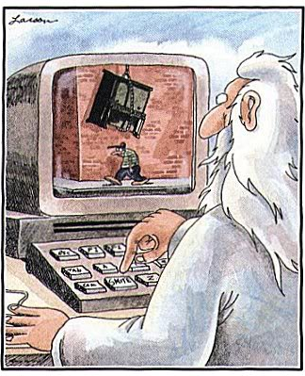
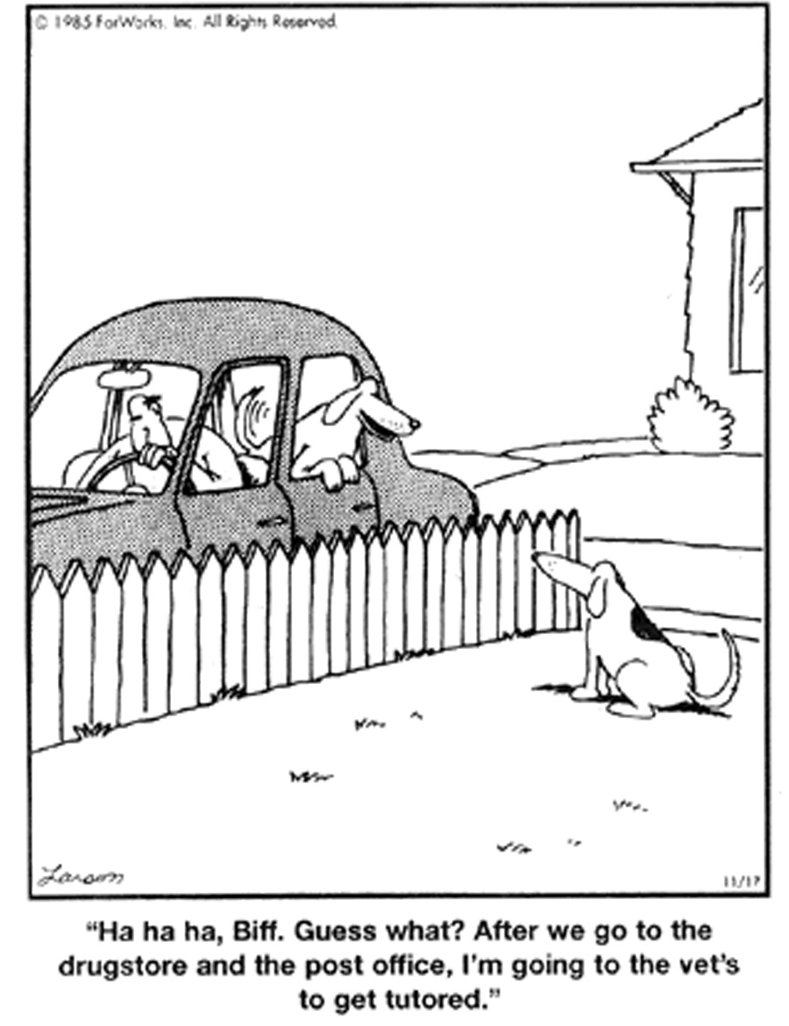
Predict what would happen. Justify your answer.

Slide 13
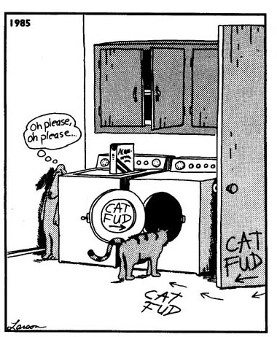
Draw conclusions. Justify your answer.

Slide 14
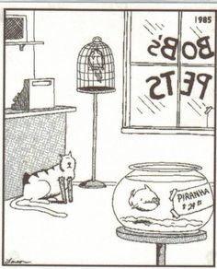
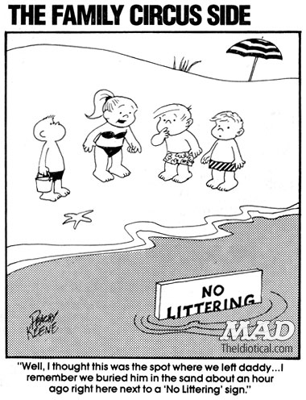
Make inferences. Justify your answer.

