Slide 1
Unit 6
power of persuasion

Slide 2
SWBAT
Name the different persuasive appeals.
Analyze faulty logic and good use of rhetoric.

Slide 3
CCSS
RI.9-10.8 Delineate and evaluate the argument and specific claims in a text, assessing whether the reasoning is valid and the evidence is relevant and sufficient; identify false statements and fallacious reasoning.

Slide 4
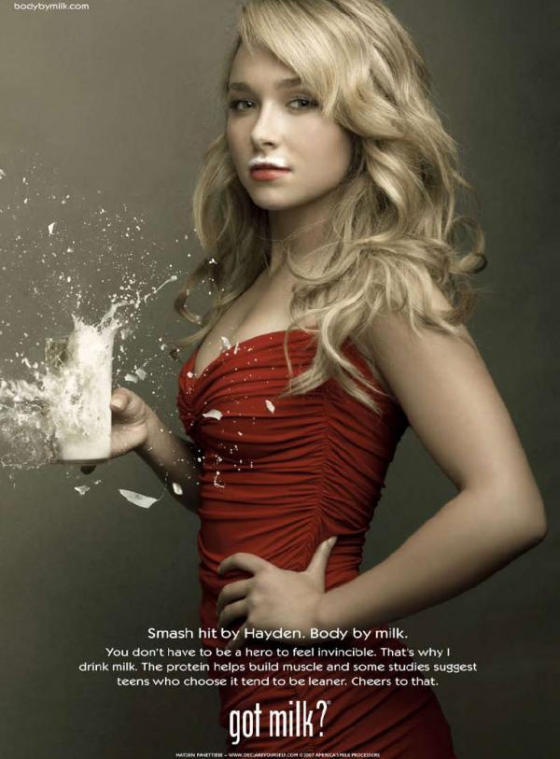
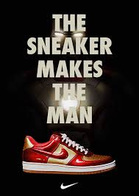
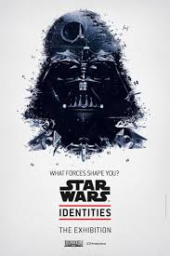
Rank these in order of most persuasive to least
Notes:
Explain your rationale. 5 min.

Slide 5
Read pp. 572-577
Take notes.
What do you learn from the text?
What jargon should we use in this unit?
Notes:
25 min.

Slide 6
Read Doing Nothing is Something pp.579-583
Define, illustrate and exemplify the following
Hiatus (581)
Deficit (581)
Prestigious (582)
Contemptuous (582)
Laudable (582)
As you read, take notes. Use the chart below.
Claim:
Reason: | Evidence:

Slide 7
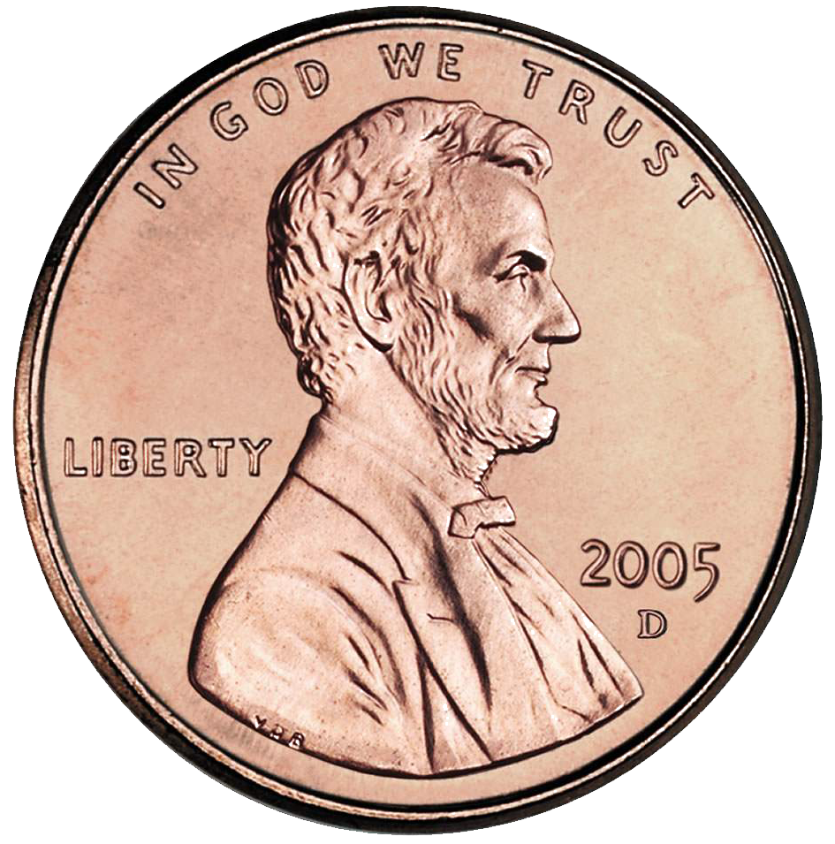
Read Abolishing the Penny Makes Good Sense pp. 586-591
Deductive Reasoning
Row 1 answer question 4
Row 2 answer question 5
Row 3 answer question 6
Row 4 answer question 7
Row 5 answer question 8
Row 6 answer question 9
General principle (implied)
Specific situation
Reasons and evidence
Conclusion

Slide 8
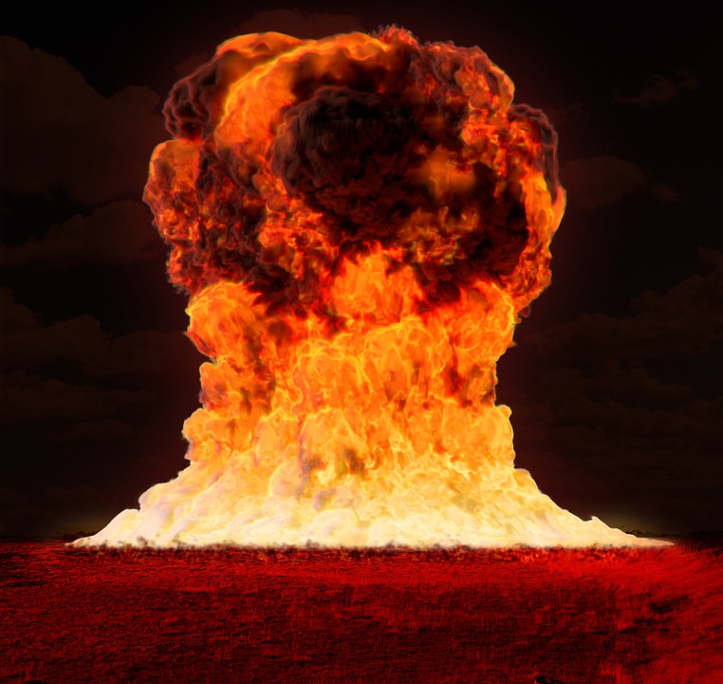
Read On Nuclear Disarmament pp. 592-600
Define, illustrate and exemplify the following:
Precursor (594)
Annihilate (596)
Carnage (597)
Contending (597)
Malice (598)
Reconcile (599)
Inductive reasoning
Evidence
Evidence
General Conclusion
Notes:
Play kahoot game after

Slide 9
Read I Acknowledge Mine pp. 604-615
Define, illustrate and exemplify the following:
Stark (606)
Boisterous (609)
Alleviate (611)
Stridently (612)
Complicity (614)
Technique | Example
Rhetorical question
Emotional appeal
(Come up with another on your own and label here. Refer to p. 574 for ideas.)
Notes:
Watch this video before reading: https://www.youtube.com/watch?v=eeASUdvLLnY (3:09 min)
Play kahoot game after reading

Slide 10
Read Use of Animals in Biomedical Research pp. 618-625
Define, illustrate and exemplify the following:
Speculative (623)
Rhetoric (623)
Proponent (624)
Impede (624)
Opposing View | Counterargument | Support for counterargument
Animal experimentation isn’t necessary. | Most modern medical advances have required such experiments. | Many Nobel Prizes have been awarded for medical research involving animals.

Slide 11
Read A Chip of Glass Ruby pp. 628-641
Define, illustrate, and exemplify the following:
Repute (632)
Disarm (633)
Patronized (633)
Presumption (633)
Morose (634)
Write a response in your notes:
Make a list of important problems in society. Choose the problem that you care about the most, and write a paragraph explaining what you would be willing to sacrifice to help overcome it.
Answer problems 5,6,10 on p. 641
Notes:
Maybe we will have time to analyze the Time magazine yoga article or a clip from TNG

